Slide 1

Life Expectancy Data Analysis
Irfana perveen
C5_Data analytics

Slide 2
A statistical measure of the average time a person or a group of people is expected to live.
- Life expectancy

Slide 3
Variables:
Country- Country
Year- Year
Status- Developed or Developing status
Life Expectancy- Age(years)
Adult Mortality- Adult Mortality Rates of both sexes(probability of dying between 15&60 years per 1000 population)
Infant Deaths- Number of Infant Deaths per 1000 population
Alcohol- Alcohol, recorded per capita (15+) consumption (in litres of pure alcohol)
Percent Expenditure- Expenditure on health as a percentage of Gross Domestic Product per capita(%)
Hep B- Hepatitis B (HepB) immunization coverage among 1-year-olds(%)
Measles- number of reported measles cases per 1000 population

Slide 4
Continued
BMI- Average Body Mass Index of entire population
U-5 Deaths- Number of under-five deaths per 1000 population
Polio- Polio(Pol3) immunization coverage among 1-year-olds(%)
Total Expenditure- General government expenditure on health as a percentage of total government expenditure(%)
Diphtheria- Diphtheria tetanus toxoid and pertussis (DTP3) immunization coverage among 1-year-olds(%)
HIV/AIDS- Deaths per 1000 live births HIV/AIDS(0-4 years)
GDP- Gross Domestic Product per capita(in USD)
Population- Population
Thinness 10-19- Prevalence of thinness among children and adolescents for Age 10 to 19(%)

Slide 5
Continued
Thinness 5-9- Prevalence of thinness among children for Age 5 to 9(%)
Income Composition- Human Development Index in terms of income composition of resources(0-1)
Schooling- Number of years of Schooling

Slide 6
Exploration Of Data

Slide 7
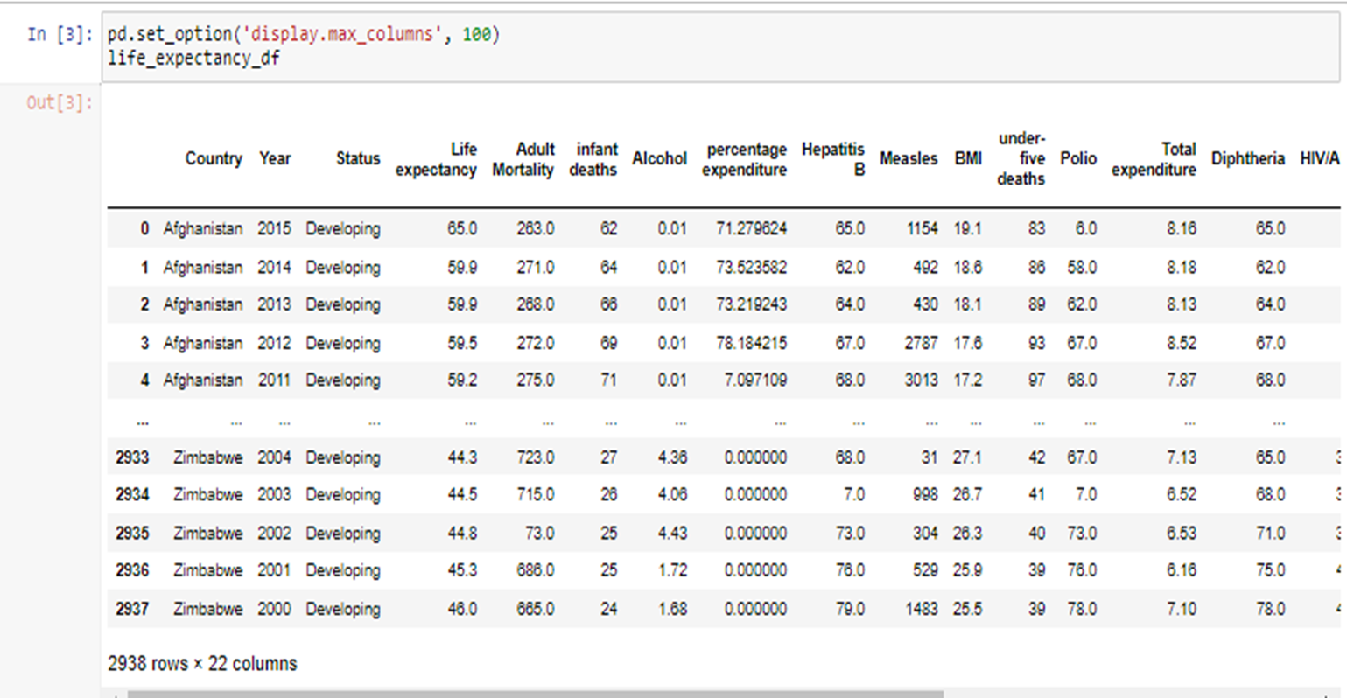
Dataset
It has 2938 rows and 22 columns
Having data of 16 years from the period 2000 to 2015 of 193 countries.

Slide 8
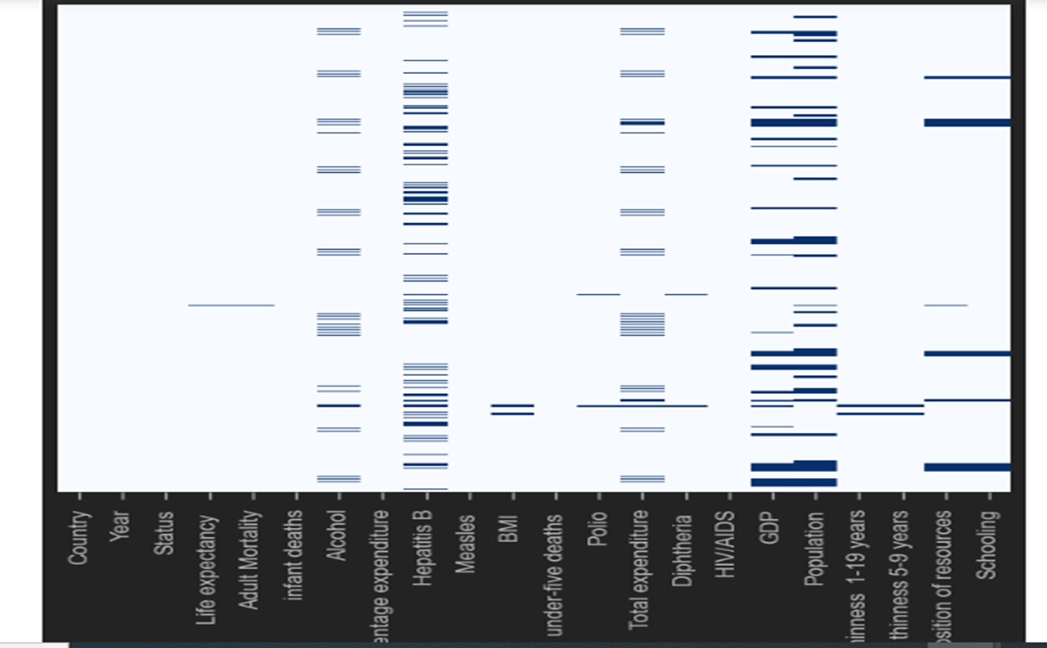
Missing values
The dataset has missing values:
Population 652
Hepatitis B 553
GDP 448

Slide 9
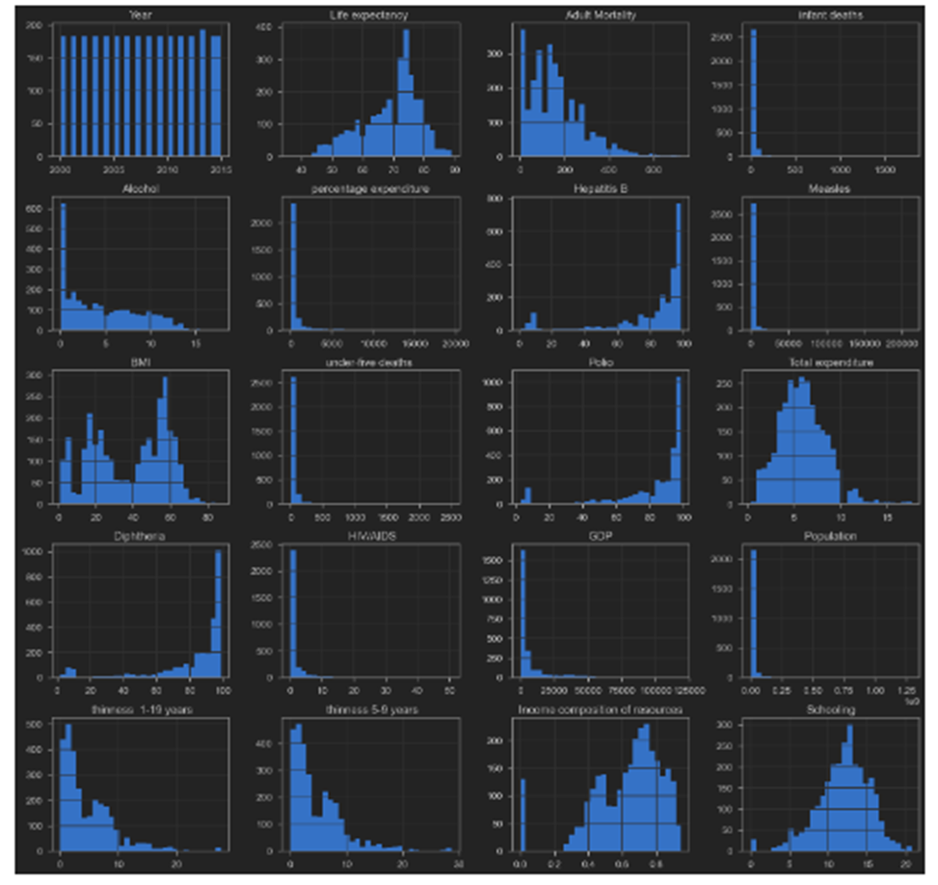
Histogram
Showing the spread/distribution of the variable in the data.

Slide 10
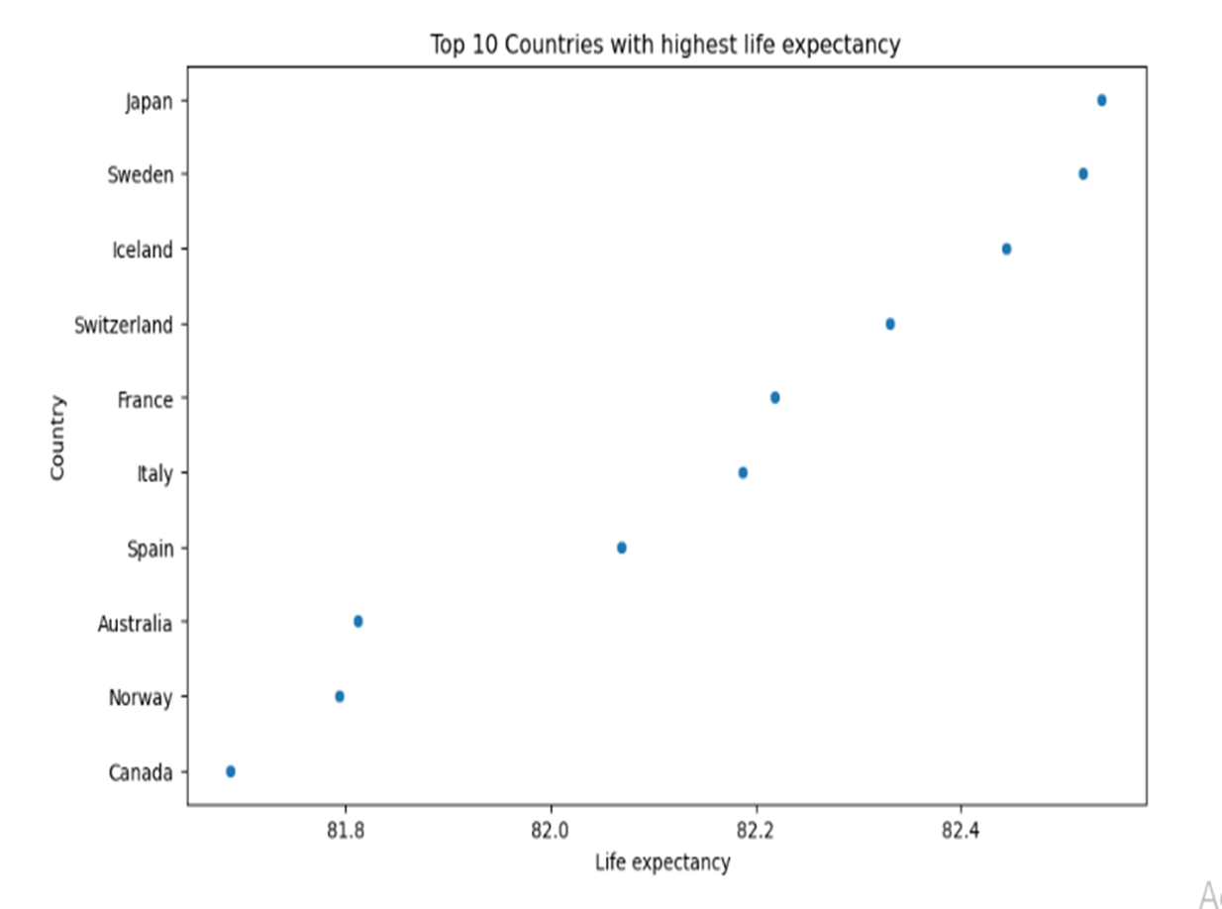
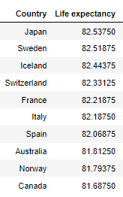
Top 10 Countries
The highest expectancy is 82.54 in Japan followed by Sweden, Iceland, and others

Slide 11
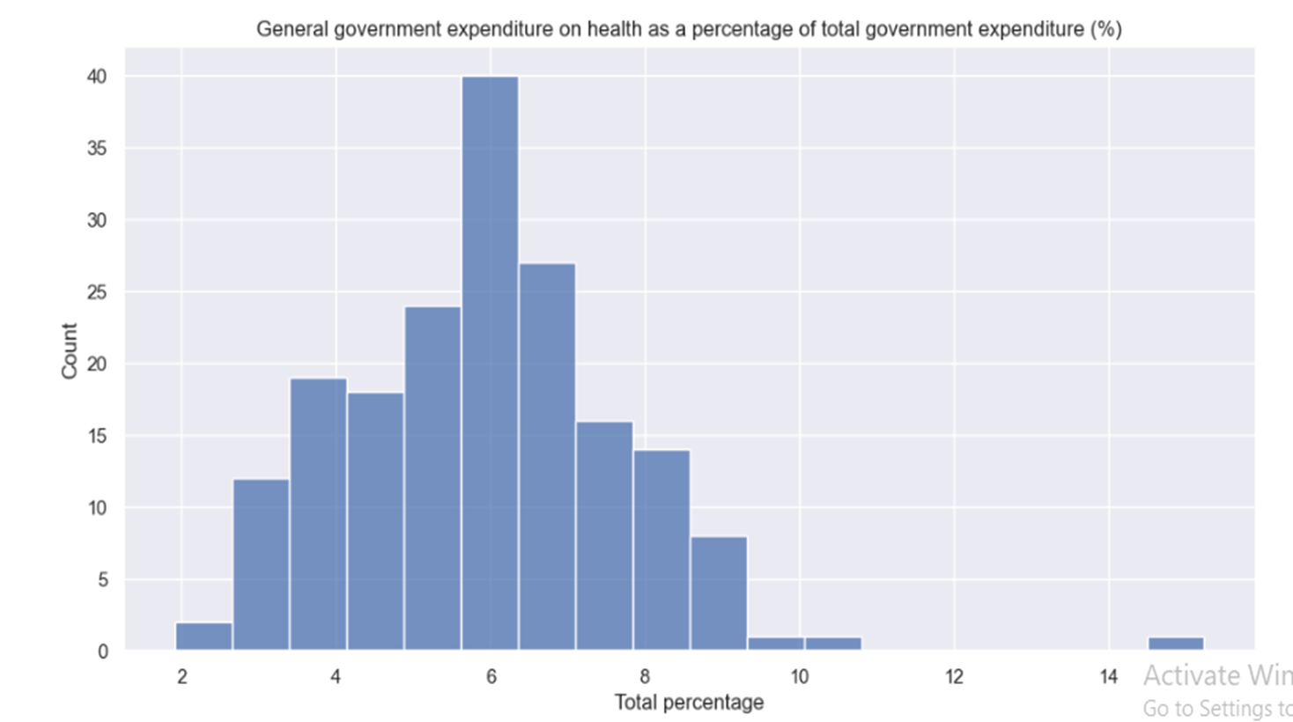
Govt. expenditure on health
It seems that most the countries spend 3-8% on health.

Slide 12
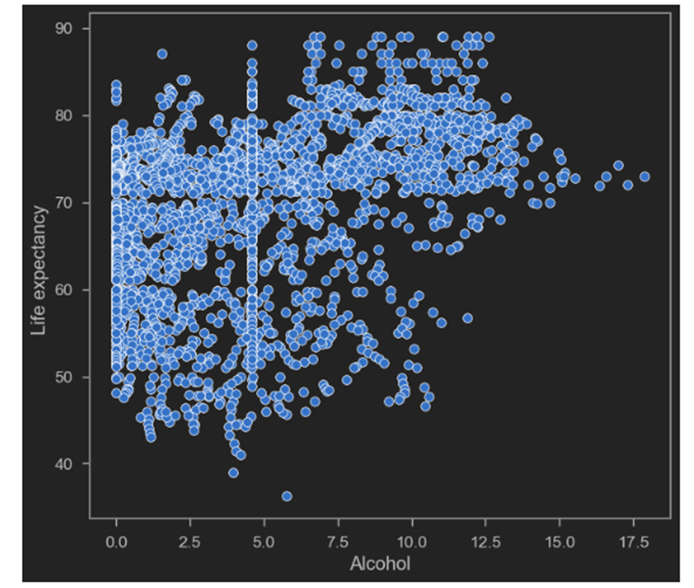
Alcohol
Interesting variable, although the consumption of alcohol has a very adverse effect on the individual’s health, ultimately leading to lower life expectancy.

Slide 13
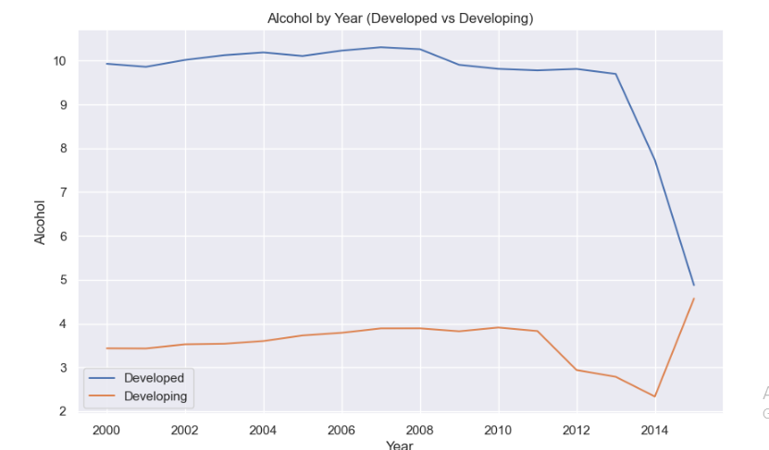
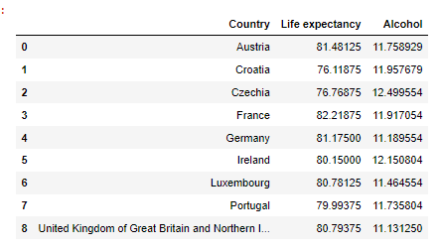
continued

Slide 14
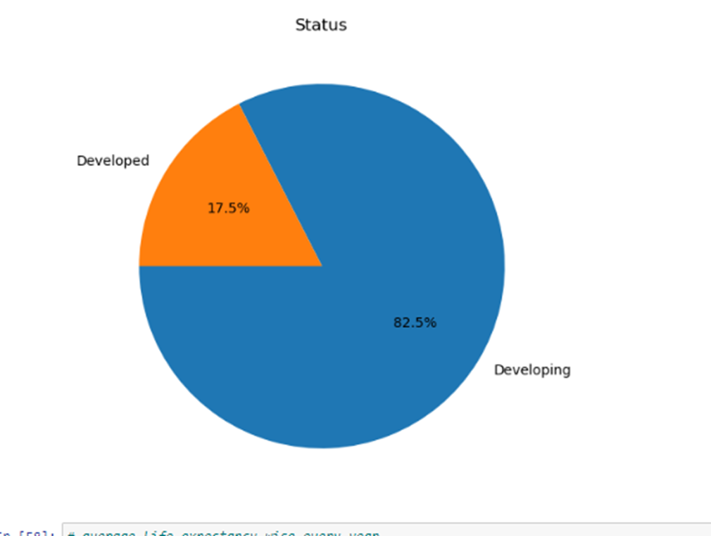
Status
Our data comprises 193 nations which are segregated by the status of developed and developing countries.
Developing 161 82.5%
Developed 32 17.5%

Slide 15
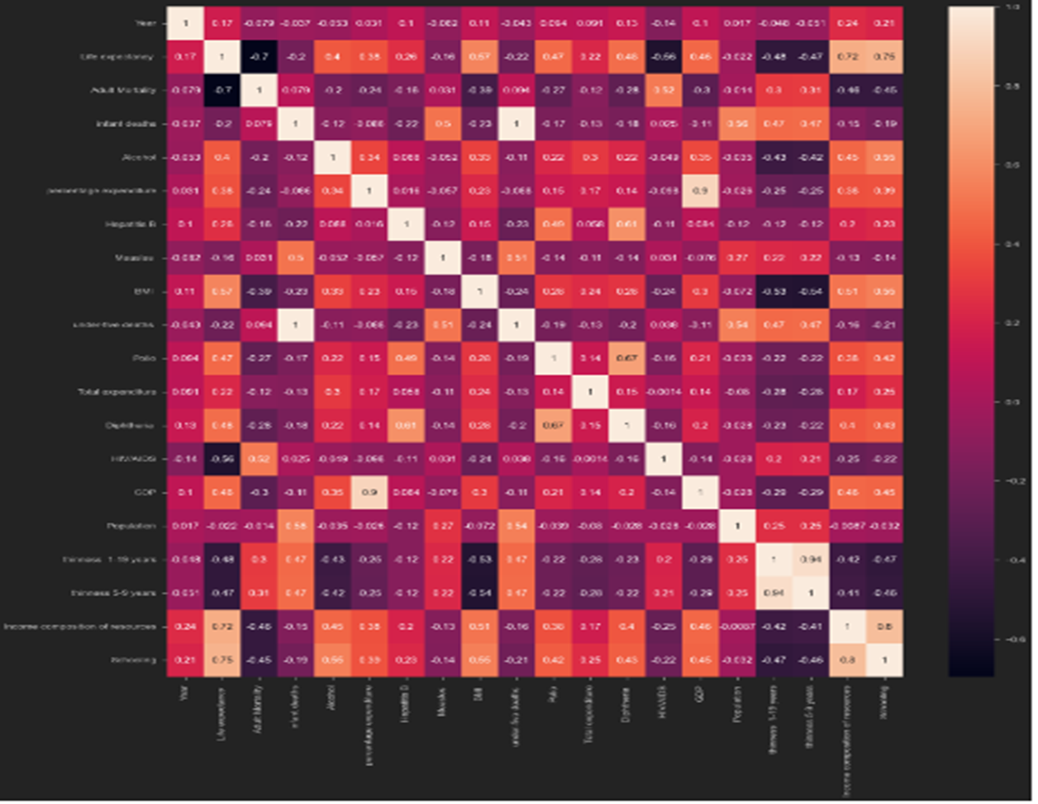
Corr. matrix
Combination of interests are:
p(life expectancy, schooling) = 0.75
p(life expectancy, in.com.of.res) = 0.72
p(schooling, in.com.of.res) = 0.8

Slide 16
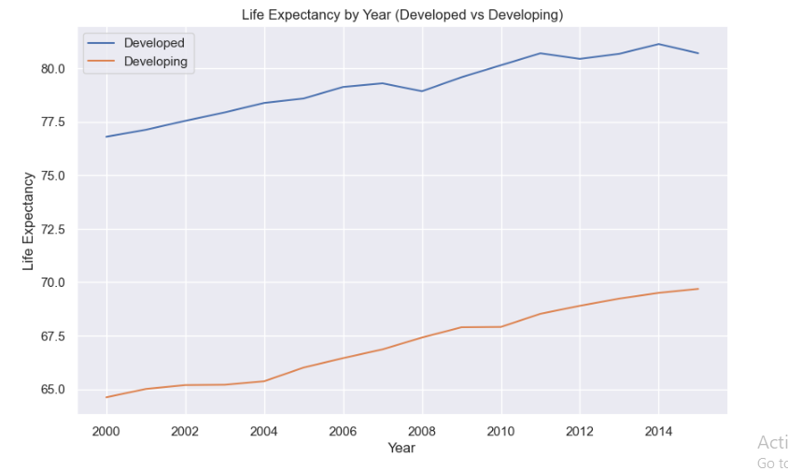
Life Expectancy
Life expectancy has grown for both developed and developing countries. However, developing countries increased at a higher rate.
This graph implies that we have to look at variables status wise separately.

Slide 17
Hypothesis: there is a significant difference in the means of developing and developed countries.
We tested this hypothesis for all three variables of interest.
And the overwhelming values of t-statistic confirmed the statement that there is a significant difference in the means of developing and developed countries.
Developed and developing countries’ t-values:
Life expectancy = 47.86
Schooling = 44.57
Income composition of resources = 55.57

Slide 18
Correlation Of Schooling And Life Expectancy
Taking correlation separately for developing and developed countries.
Developed countries correlation = 0.39
Developing countries correlation = 0.68

Slide 19
Correlation Of in.com.of.res And Life Expectancy
Taking correlation separately for developing and developed countries.
Developed countries correlation = 0.72
Developing countries correlation = 0.64

Slide 20
Correlation Of In.com.of.res And Schooling
Taking correlation separately for developing and developed countries.
Developed countries correlation = 0.62
Developing countries correlation = 0.74

Slide 21
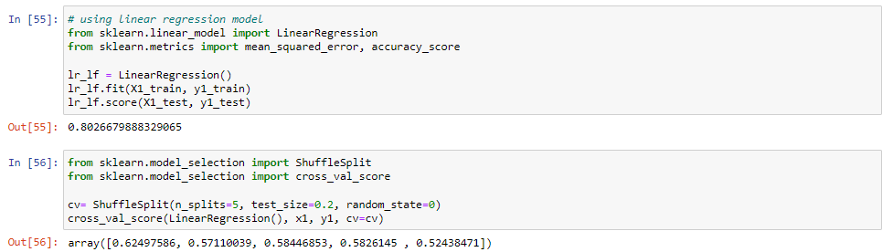
Data modeling for prediction
Try to apply linear regression. However rejecting the linear regression

Slide 22
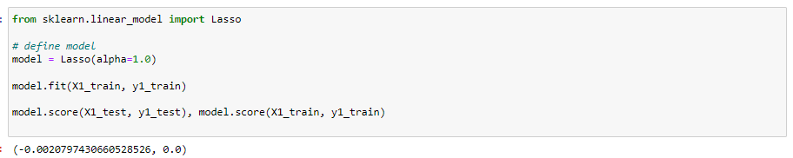
continued
Also tried Lasso but it also wasn’t working

Slide 23
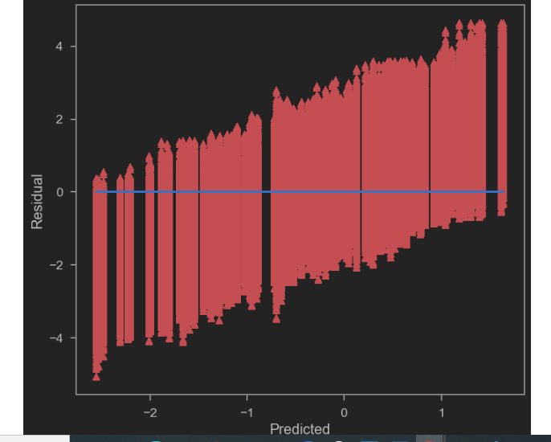
continued
Then we applied Decision Tree and its work.

Slide 24
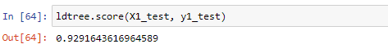
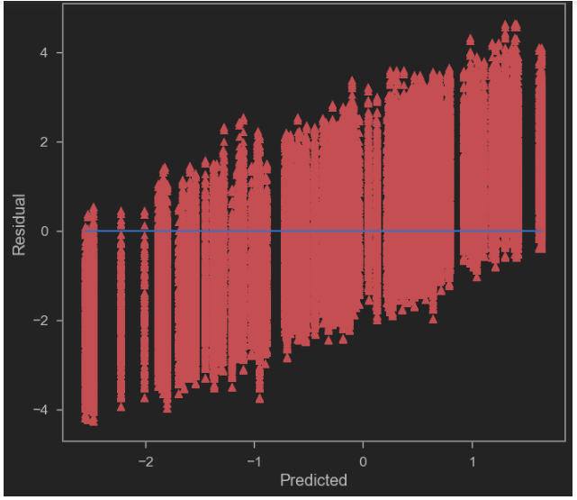
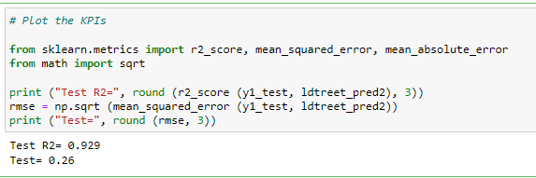
continued

Slide 25


